Slide 1


Slide 2
NATURAL VENTILATION

Slide 3
Air flows from a region of high pressure to a region of low pressure.
The difference of pressure may be caused by
  Purely natural means: called natural ventilation, or
  By a fan: called mechanical ventilation.
Small and shallow mines are sometimes ventilated by natural means.
Ventilation only through natural means is usually
  Poor
  Fluctuates to a large extent and
  Subject to reversal of direction.
In case of emergency such as fires underground, mechanical ventilation is more effective.
However, natural ventilation does play a role in all mechanically ventilated mines.

Slide 4
CAUSES OF NATURAL VENTILATION
The causes of natural ventilation are
Temperature
Moisture content of the air
Barometric pressure
Addition of gases
Leakage of air
Circulation of refrigerated air
Other factors

Slide 5
Temperature
Natural ventilation is caused by the difference in densities of air in the upcast and downcast shafts.
The heavier air sinks down and the lighter air moves up thus setting up an air-current.
The difference in air densities is mainly caused by the heating of air in the mine workings due to the addition of heat from rocks, men, machinery, lights spontaneous heating etc.
Auto-compression in the downcast shaft changes the air density according to the theoretical relation
  ρ α P^{1/2}

Slide 6
The effect being maximum at the bottom of the shaft, but the reverse process takes place in the upcast shaft due to auto-expansion.
Theoretically, there is no difference between the average air densities in the two shafts and hence no natural ventilation due to auto-compression and auto-expansion.
In practice a slight effect on natural ventilation is exerted by the two processes being non-isentropic and occuring at different average temperatures.
Moisture content of the air
As moisture is lighter than air, addition of moisture in the downcast shaft decreases the density of air.
Presence of moisture also causes evaporative cooling of the downcast air and consequent increase in its density which aids natural ventilation.

Slide 7
Barometric pressure
It is well known that air density is a function of barometric pressure.
If the mean barometric pressure of the downcast air column is higher than that of the upcast air column, it helps natural ventilation and vice versa.
However, since barometric pressure rarely varies to any appreciable extent from place to place within the limits of a mining property, the effect of such variation on natural ventilation is negligible.
Addition of gases
Methane emitted from the workings of coal mines reduces the density of return air thus aiding natural ventilation.
Addition of compressed air from the exhaust of the compressed-air machinery used underground, has little effect on the density of air.

Slide 8
Leakage of air
In multilevel mine, leakage of denser downcast air to the upcast shaft causes an increase in the density of upcast air, thus reducing natural ventilation.
In view of the low efficiency of natural ventilation, of the order of 1.4 to 1.6% it is important to minimize leakage of air from downcast to upcast shaft in order to get the maximum benefit of natural ventilation.

Slide 9
Circulation of refrigerated air
Circulation of refrigerated air through the downcast shaft increases the density of downcast air thus aiding natural ventilation.
In some of the deep and hot mines such as Robinson Deep of the Rand, SA, where refrigerated air is sent down the intake shaft, the N.V.P. is estimated to be of the order of 1200 Pa.
Other factors
Presence of fire in one of the shafts. The fire heats up the air which has then less density.
Passage or spraying of cold water in the downcast shaft for preserving shaft timber from dry rot or minimizing fire hazard etc.
Having steam pipes or stem purposely introduced in upcast shaft help natural ventilation by decreasing the upcast air density.
Movement of cage in the shaft.
Unequal depth of the shafts.

Slide 10
DIRECTION OF NATURAL VENTILATION
This depends mainly on the depth of the mine as the depth generally controls the amount of heat added to the mine air.
In shallow mines, where the underground temperature is not very high, the surface temp. is the major contributing factor to the direction of natural ventilation.

Slide 11
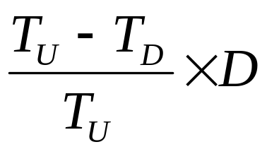
Motive column and N.V.P.
In case of natural Ventilation it is the excess weight of air in D.C. air column which gives to the Natural Ventilating Pressure (N.V.P.).
The height of this excess weight of air column of DC shaft 1 m² in cross section which gives rise to N.V.P. is called motive column.
In other words, it is the unbalanced part of the whole DC column, 1 m2 in cross section, i. e. that part of the DC column which is not balanced by the UC air column.
Motive column is given by
    h =
Where
TU = average temperature in upcast shaft, K
TD = average temperature in downcast shaft, K
D = depth of column between top of the higher-level shaft and bottom of the deeper shaft, m
N. V. P. = Motive column × density of air in DC shaft, pa

Slide 12
Determination of N.V.P. from thermodynamic considerations
The thermodynamic approach developed by Hinsley (1950-51).
The mine-ventilation system can be compared to a heat engine with the following cycle:
a. Air descending the downcast shaft undergoes auto-compression, as a result of which its pressure and temperature increase and specific vol. decreases.
b. As air travels through the mine workings, heat is added from rocks to the hot and compressed air, thus increasing its temperature. As a result, its specific vol. increases, but pressure decreases.
c. In upcast shaft, auto-expansion leads to increase in its specific vol., but pressure and temp. fall.
d. Finally, heat is rejected by the air to the atmosphere and the air returns to the atmospheric condition of pressure, specific volume and temperature thus completing the cycle.

Slide 13
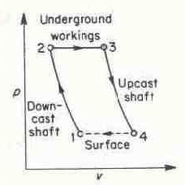
Adiabatic processes occur in the shafts, and expansion occurs at constant pressure through the workings.
An indicator diagram can be plotted for the mine ventilation system on P-V (pressure-specific vol.) coordinates.
Fig. Indicator diagram for mine ventilation system

Slide 14
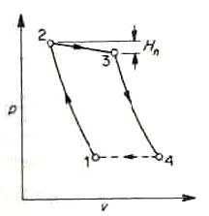
Case I: Mine ventilated by natural means only
The actual cycle for a mine with natural ventilation only shown in Fig.
The pressure difference between points 2 and 3 is equal to the natural ventilation head Hn, neglecting head loss in shafts.

Slide 15
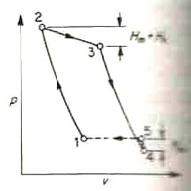
Case II: Mine ventilated by fan plus natural means
Diagram for a mine with fan plus natural ventilation is shown in figure.
In this case, the natural ventilation head is equal to the pressure difference between points 2 and 3 less the fan head Hm.

Slide 16
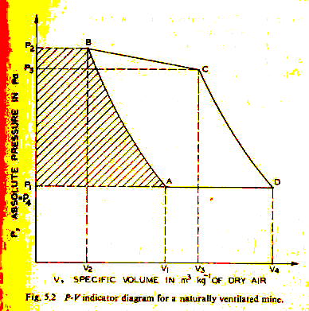
The work of natural ventilation
Consider a unit mass of dry air entering the downcast shaft and undergoes auto-compression.
Assuming no heat or moisture exchange between the shaft wall and the air, the process of auto-compression is a frictional adiabatic (Curve AB).
Fig. P-V indicator diagram for a naturally ventilated mine

Slide 17
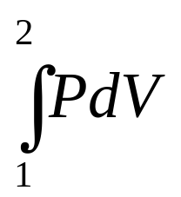
In the downcast shaft
The flow work of air entering the shaft
W_{fli} = P1V1 (area OV1AP1)
The work done on the air by auto-compression
W_{c} = (Area V1ABV2)

Slide 18
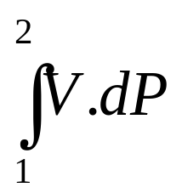
The flow work out of the shaft
W_{flo} = - P2V2 (area OV2BP2)
The total work done on the air in the downcast shaft
W_{dc} = W_{fli} + W_{c} +W_{flo} = P1V1 + - P2V2 = - (area P2BAP1)
Note: since the work is one of compression done on the air it is –ve
ʃd(PV) = ʃPdV + ʃVdP , Also ʃd(PV) = P2V2 – P1V1
Hence ʃPdV + ʃVdP = P2V2 – P1V1
Or P1V1 + ʃPdV – P2V2 = - ʃVdP
Where
P = absolute pressure of air
V = specific vol. (vol. per unit mass)

Slide 19
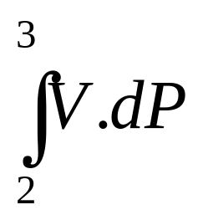
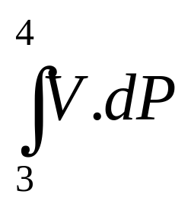
Similarly, the work done on the air in the mine workings
W_{w} = - (area P2BCP3)
Work done on the air in upcast shaft
W_{uc} = - (area P3CDP4)

Slide 20
Total work done on the air in the mine
Wt = Wdc + Ww + Wuc = - - -
(area ABCD)
P1 is taken equal to P4 since the upcast and downcast shaft-tops are assumed at the same elevation.
When there is no external work done on the air (i.e. there is no fan in the ventilation system), the above work is the work natural ventilation due to addition of heat in the mine workings

Slide 21
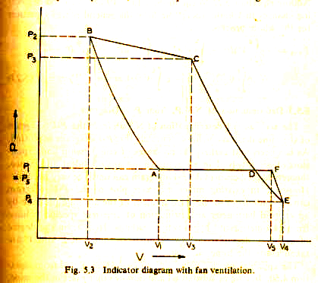
Work of natural ventilation with mechanical ventilation
When mechanical ventilation aiding natural ventilation, the P-V diagram becomes as in Fig.
Considering the exhaust fan at the top of the upcast shaft, the expansion curve CD extends down to E.
In other words, the pressure of air at the top of the upcast shaft P4 is no longer equal to P1 but less than P1.
P1 – P4 = the depression created by the fan
The air is however, compressed back by the fan to P1, the atmospheric pressure, the compression following the curve EF.
Fig. P-V indicator diagram with fan ventilation

Slide 22
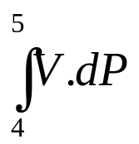
The total work done by natural agency as well as the fan
= - - - is given by area P1ABCDEP4
Out of which work done by the fan alone Wf = -
is given by area P1FEP4
So the work done by N. V. P. is given by the area ABCD – DEF
But since the area DEF is very small, it can be neglected and the N. V. P. will then be calculated from the work done as represented by the area ABCD only.

Slide 23
Determination of N.V.P from P-V diagram
Accuracy of determination of NVP from P-V diagram of the mine depends on how accurately the P-V diagram is plotted.
An exact plot of P-V diagram can be made
  from actual measurement of the absolute pressure by an aneroid barometer and
  estimation of apparent specific vol. of air from barometric and hygrometric readings using the following equation:
  V = 287.1 T / [1000 (B – e)] m³/kg
  Where
  B = barometric pressure, kPa
  e = vapour pressure, kPa
  T = temp. in K

Slide 24
The area of indicator loop on the P-V diagram gives the power of natural ventilation.
Dividing it by a reference specific vol. of air (usually at the fan inlet) gives the N.V.P.

Slide 25
Other methods of determining N.V.P.
Other practical methods used for finding NVP in mines are
From pressure and quantity measurements with fan running and fan stopped
With the fan running, the mine resistance
R = (P_{f} + P_{n})/Q_{f}²
With fan stopped, R = P_{n}/Q_{n}²
Where
Pn = N. V. P.
Pf = fan pressure (fan drift pressure)
Qn = quantity flowing through the mine with fan stopped
Qf = quantity with fan running
From both equations, P_{n} = P_{f}. Q_{n}² / (Q_{f}² – Q_{n}²)

Slide 26
2. From pit-bottom pressure with fan running and fan stopped
Let
p_{n} = pit-bottom pressure with fan stopped and
p_{f} = pit-bottom pressure with fan running
p_{n} = Pn – RsQn² = Pn (1 – Rs/R)
Where, Rs = shaft resistance
Similarly,
p_{f} = (Pn + Pf) (1 – Rs/R)
Combining both equations
p_{f} / p_{n} = (Pn + Pf) / Pn
Or Pn = Pf . p_{n} / (p_{f} - p_{n} )

Slide 27
3. From fan pressures and quantities at two different speeds
If Pf1 and Pf2 be the fan pressures and Q1 and Q2 the quantities at speeds N1 and N2 respectively and
R, the resistance of the mine, then
R = (P_{n} + P_{f1}) / Q₁² = (P_{n} + P_{f2}) / Q₂²
The N.V.P., P_{n} can be found from the above equation.

